Slide 1


Evaluating Predictors of Breeding Waterfowl Population Abundance and Distribution
in the Central Interior Plateau of British Columbia
2007-2017
Society for Conservation GIS
Yuriko Hashimoto
Advisor: Dr. Julian D Avery
July 15, 2019
Notes:
GIS analyst with the CWS – Canadian counterpart to USFWS. We are the federal agency responsible for migratory birds, species at risk and their habitats.
Student in Penn State’s MGIS program

Slide 2
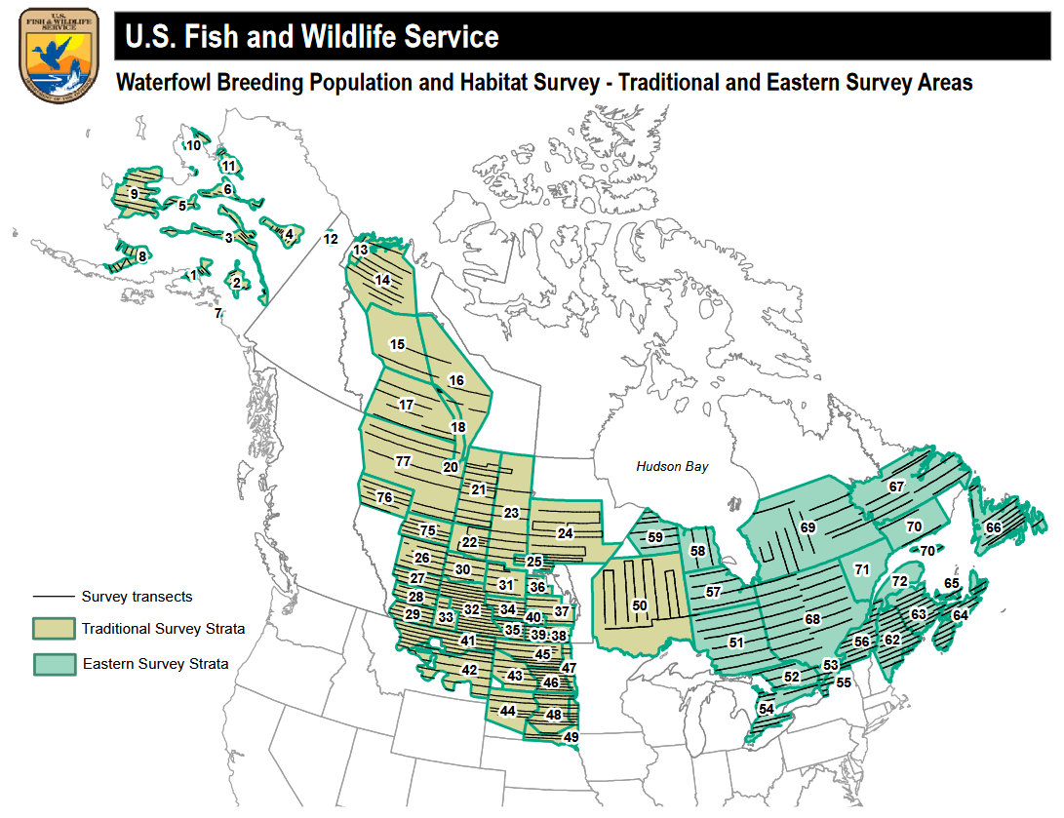
Waterfowl Breeding Population & Habitat Survey
“…arguably the largest and best-designed population survey in the world.”
– Murray et al, 2010 (Ecology, 91(2))
Notes:
Those of you in the bird world will likely be familiar with WBPHS also known as the May surveys (thankfully less of a mouthful). It has been described as “arguably the largest and best-designed population survey in the world”, continental in scale, and has been conducted on a continuous annual basis since 1955 and cited by hundreds of research publications since.
These aerial surveys monitor bird populations and their habitats which feed into annual status reports.
Those familiar with Canadian geography will note that BC is not within the Traditional Survey Area displayed in the map here. And this is because the BC extension didn’t begin in earnest until 2016.

Slide 3
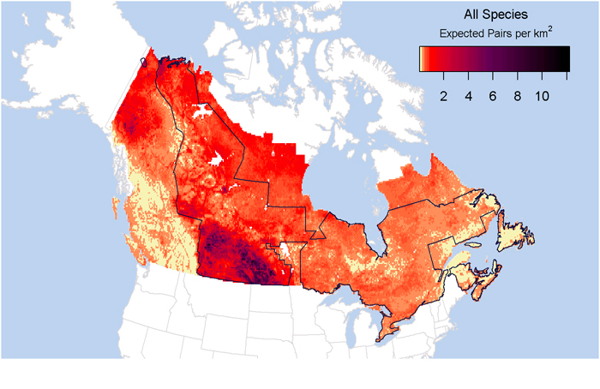
Waterfowl Distribution in Canada
Waterfowl Distribution in Canada
Barker et al, 2014
2014—First waterfowl SDM in Canada published
Based on Traditional Survey area (excluding BC)
Poor performance in out-of-sample areas
Notes:
In 2014, we were excited to see Canada’s first national scale waterfowl species distribution model published. But it was based on the Traditional Survey area, and as the authors noted, performed poorly when extrapolated to ‘out-of-sample’ areas.
The BC data wasn’t included not just because of the temporal mismatch but also because the BC surveys follow a significantly different methodology.

Slide 4
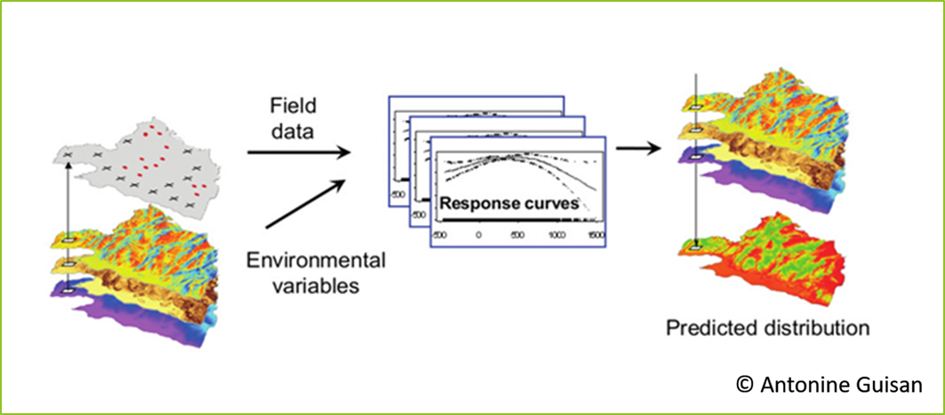
Species Distribution Models for BC
Project objective:
Develop species distribution models for BC
Inform conservation planning/management
Open data → Tools & information
GIS
Notes:
So my project objective was to fill this gap and develop predictive models for waterfowl in BC. Ultimately to inform conservation planning and support the management of waterfowl and wetlands and additionally, with recent Open Data Initiatives there’s been a shift in government to recognize data as a strategic asset and manage data as a public good. This has been pushing the creation of value-added, interpreted data products and I wanted to put policy in action by leveraging BC’s May surveys dataset to create tools that highlight the power and utility of GIS as I did so.

Slide 5
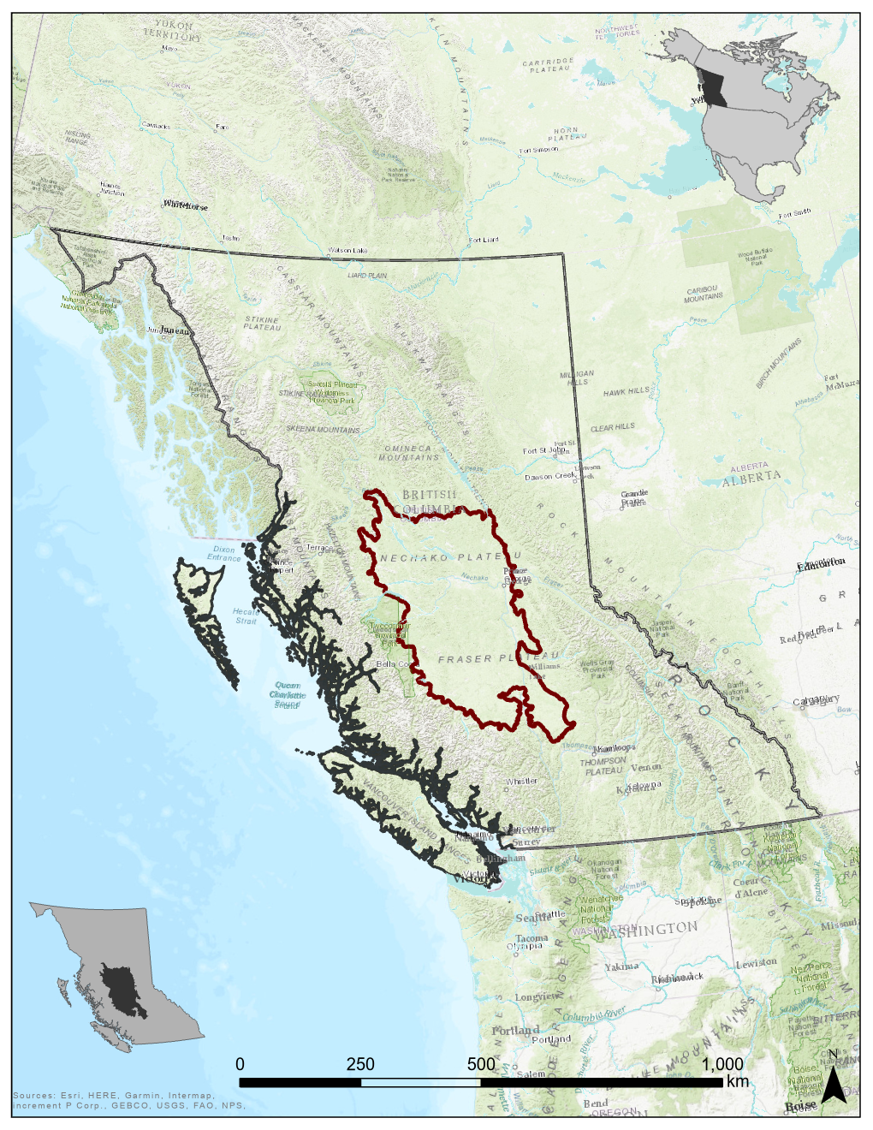
Survey Area
Central Interior Plateau
Mid-elevation ~ 800-1200m
Sparsely populated
Forestry, mining, agriculture
Survey Area ~10,714,000 ha
(41,000 mi²)
Notes:
The survey area captures the prime waterfowl habitat in BC which lies in the Central Interior. It doesn’t represent significant core habitat like the Prairie Pothole Region, but could rise in importance with the expected climate-related drying of wetlands in the PPR.
Mid-elevation plateau mostly between 800-1200m lying between the Coast Mountains and the Rockies
Main industries are forestry, mining and agriculture
Area surveyed is almost 11 million hectares roughly the size of ~ Virginia or Tennessee or the country of Iceland if that translates better for you

Slide 6
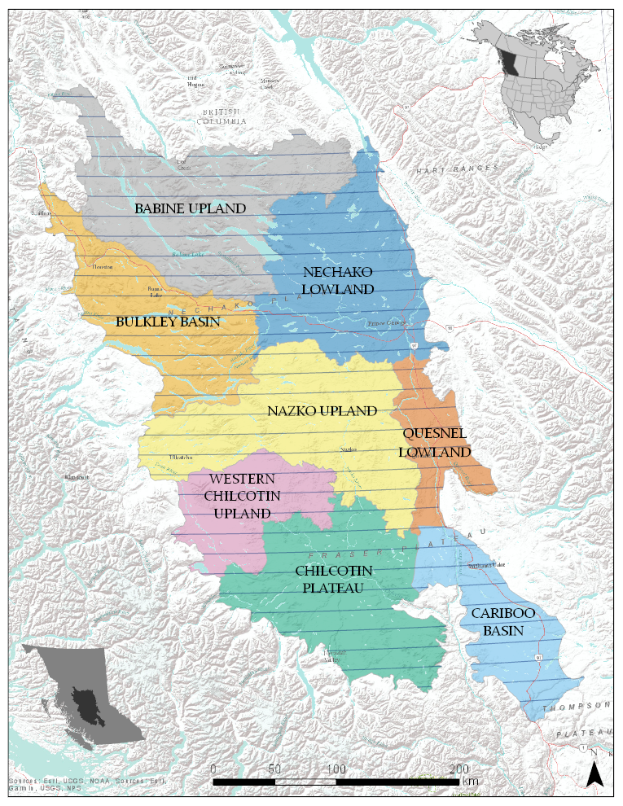


Survey Design
Aerial helicopter surveys
400m strip transects, E-W
Mobile GIS
8 Ecosections
2007 – 2017 (11 years)
30,000+ records; 27 distinct species
Notes:
Zooming in on to the study area, the surveys are conducted by helicopter along 400m wide strip transects, running E-W, and spaced 10 miles apart
Designed to span 8 Ecosections which are areas of similar climate, topography, hydrology, wildlife potential ≈ Level IV Ecoregion Classification system of North America
The time slice I’m looking at is between 2007-17
And the dataset consists of over 30,000 records capturing 27 distinct waterfowl species
Mobile GIS is used for navigation and point associated voice recordings.
~ $80,000 to conduct the survey each year - generously funded by USFWS and conducted in partnership with Ducks Unlimited
So after consolidating 11 years of data we’re looking at a Million-dollar dataset
To go back to my point about leveraging data as a strategic asset, these surveys have already met their reporting requirements, the costs for producing the data have already been covered, and their value increases as the dataset grows. Generating these species habitat models increases the rate of return on this investment for public good.

Slide 7
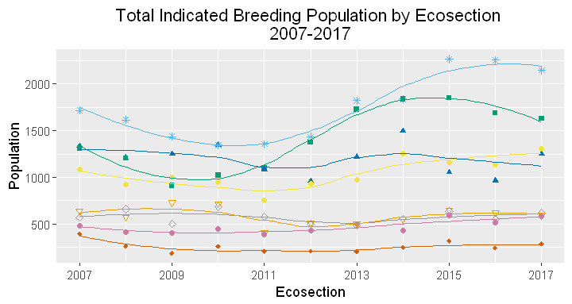
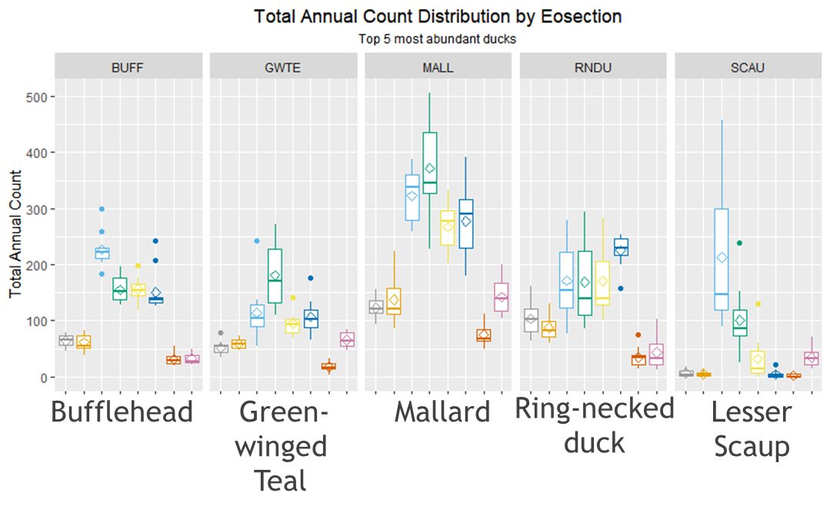

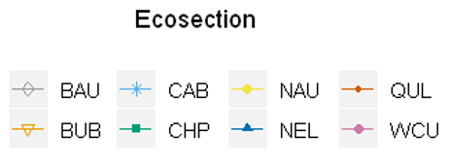
Breeding Population Trends
Total Indicated Breeding Population by Ecosection
2007
2009
2011
2013
2015
2017
Notes:
With these two plots I want to provide a very general overview of the total indicated breeding population trends and highlight the variability that exists by ecosection, year and species that the environmental predictors could help explain on a finer scale through distribution models.
On the left are boxplots of the five more abundant ducks and on the right are total counts summed by ecosection.
Most of the birds are in the southern ecosections within the Chilcotin Plateau and the Cariboo Basin - in green and light blue, respectively. The Cariboo Basin has especially dense populations.

Slide 8
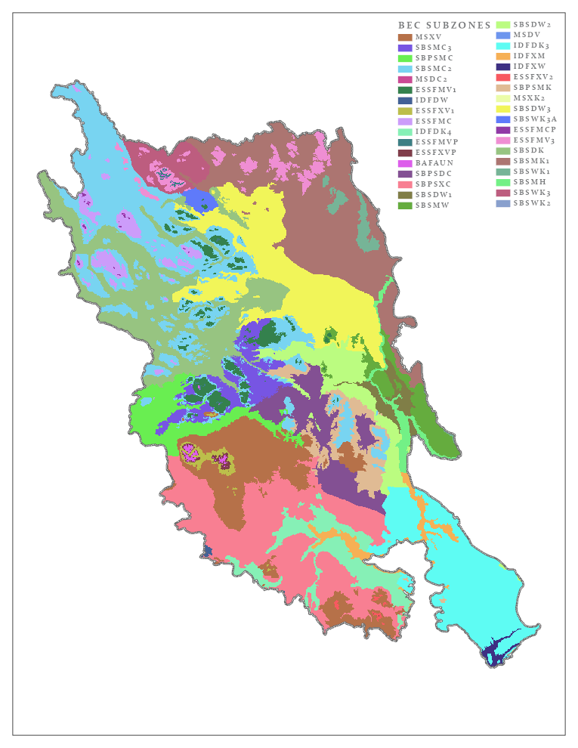
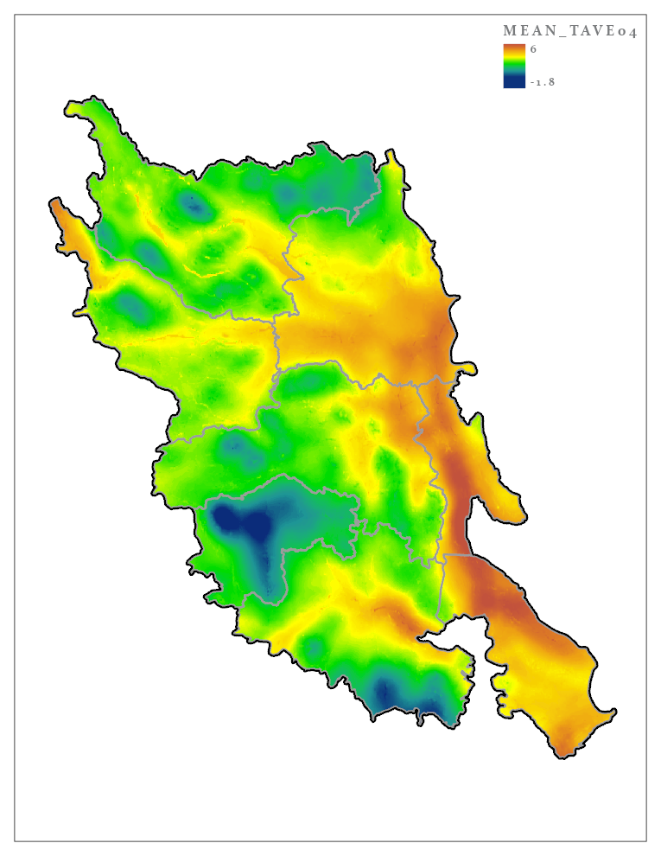
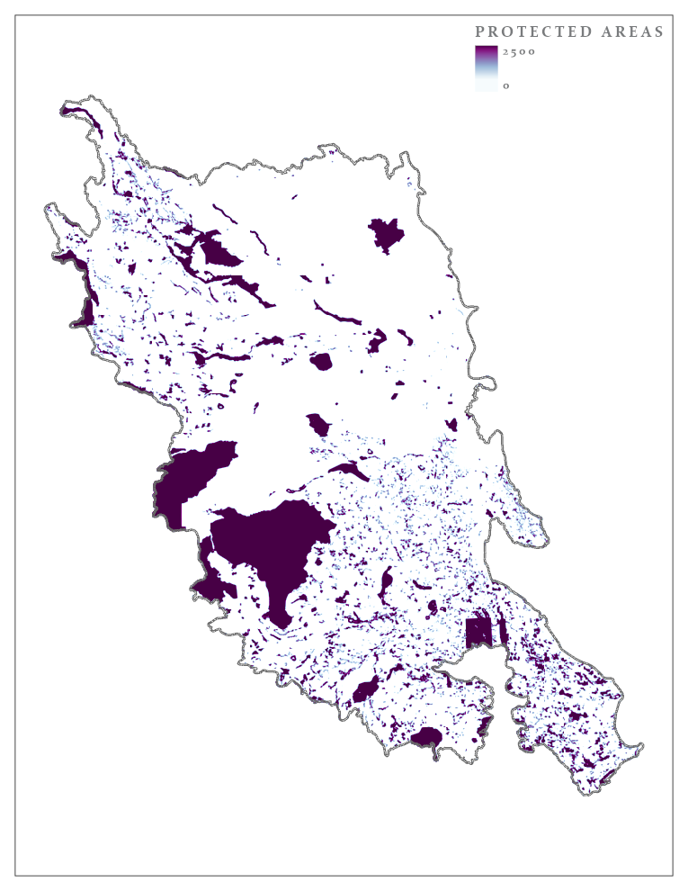
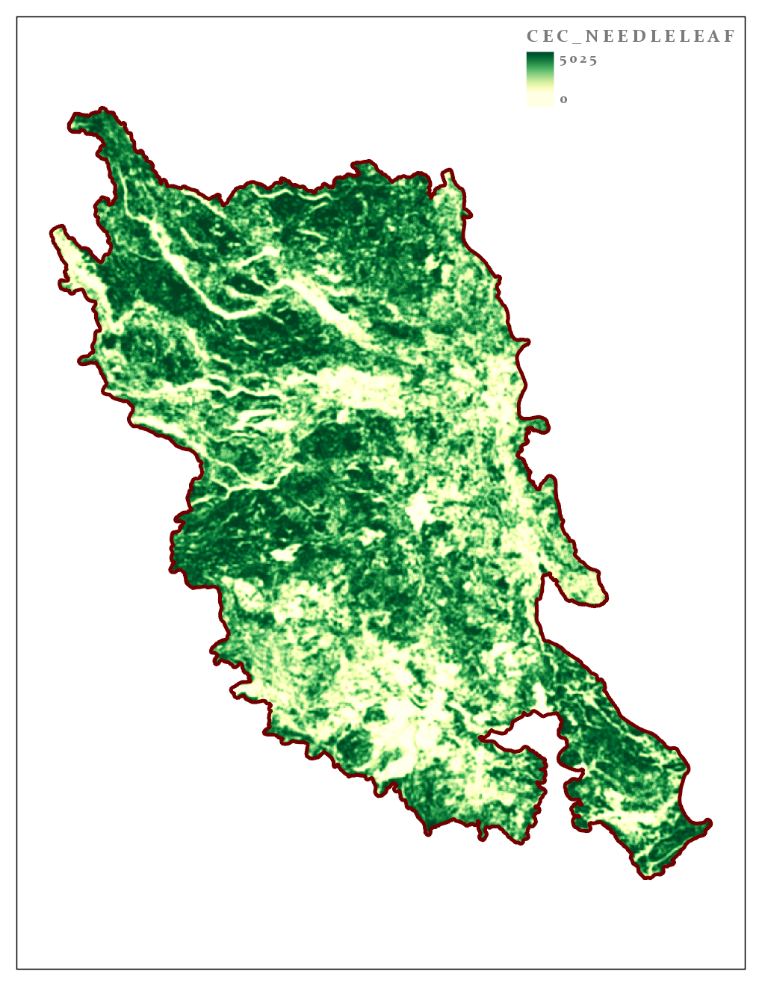
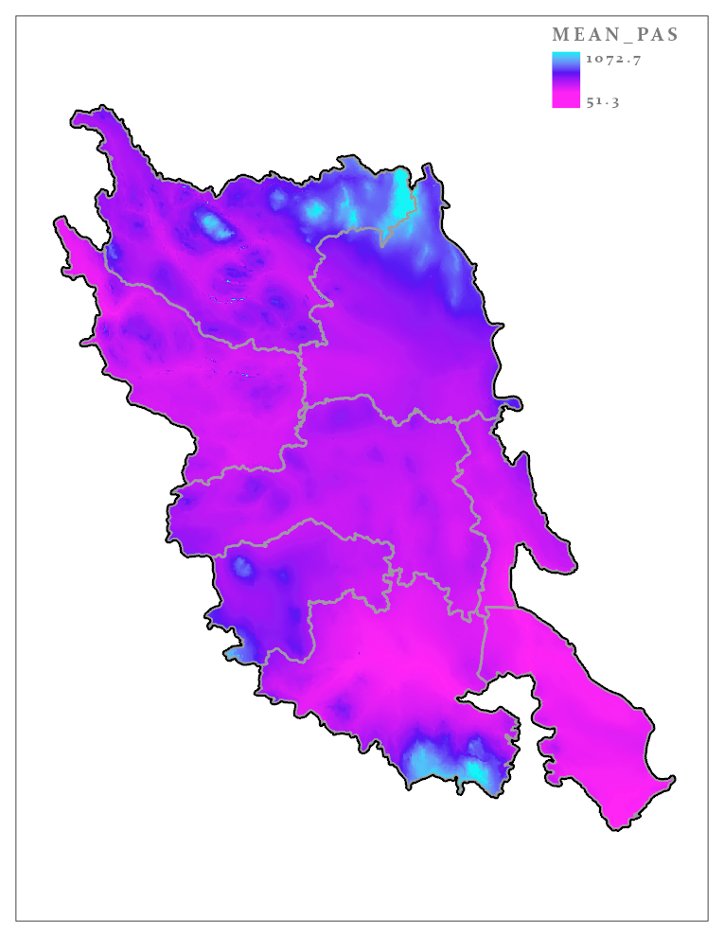
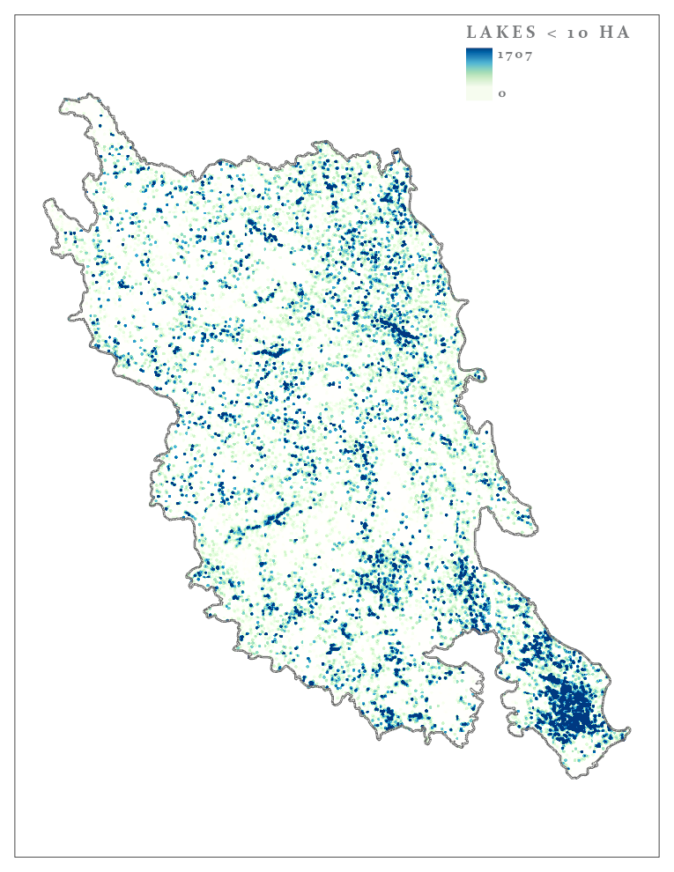
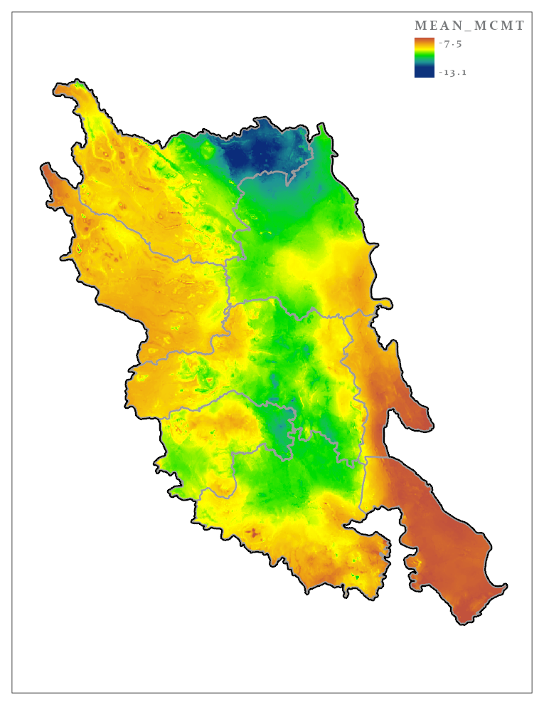
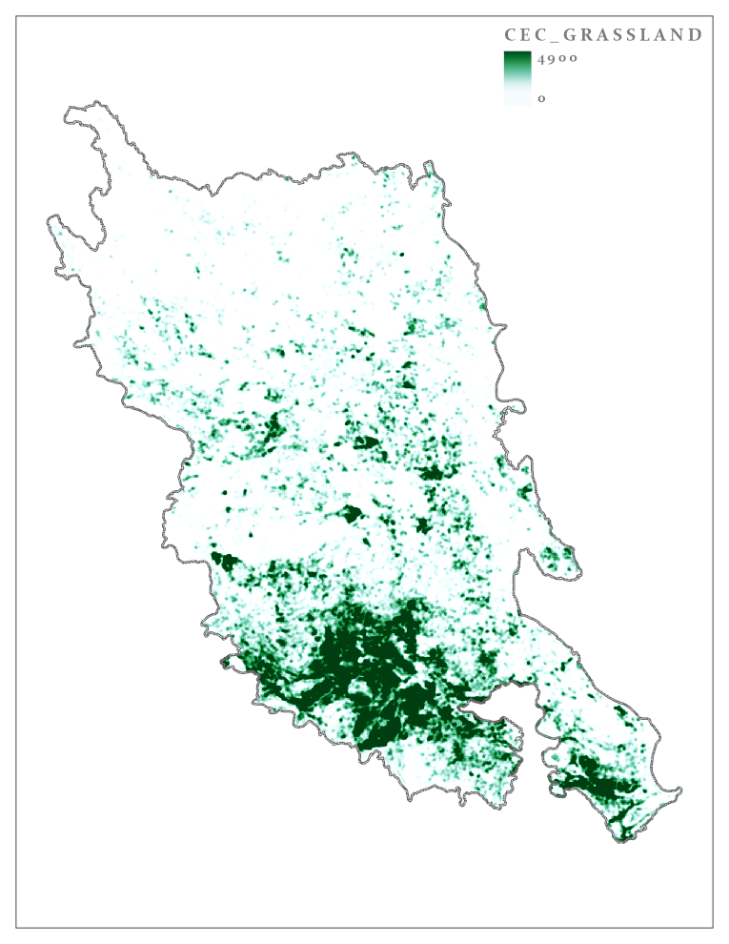
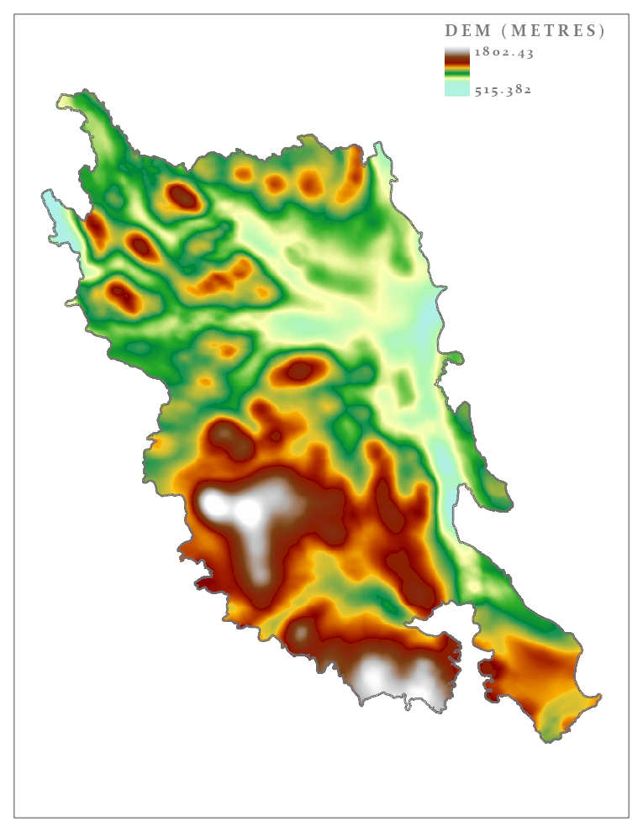
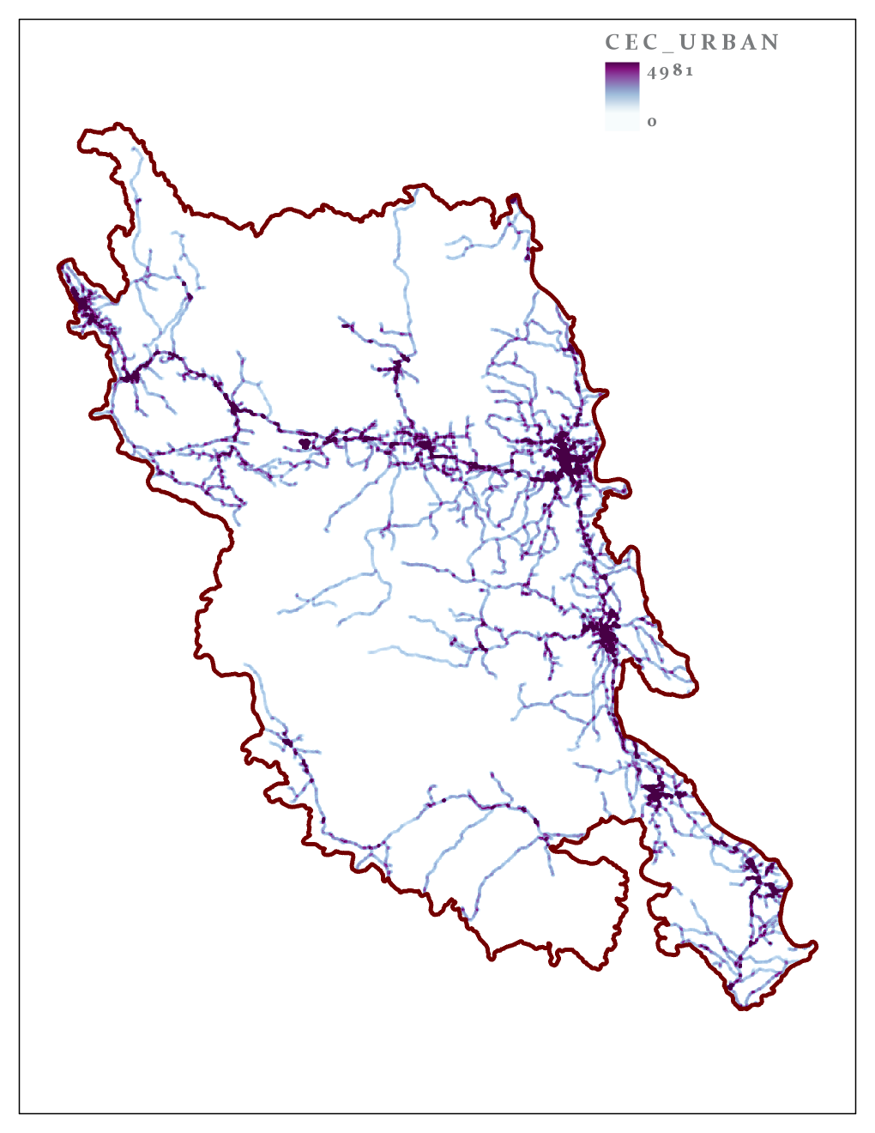
Trends and Patterns – Sample Predictors
Hydrology, Climate, Land Cover, Land Management
BEC Zones
Tave Winter
Protected Areas
Needleleaf
PAS Winter
Lakes < 10ha
Tave in April
Grassland
Elevation
Urban
Notes:
This is a small sample of some of the environmental predictors with measures mainly representing hydrology, climate, land cover, land management and disturbance. You can see that there are clear spatial patterns throughout the study area.
So the goal was to analyze and model these patterns as they relate to bird distribution and drill down into these relationships to tell a more nuanced story than these simple plots.
Species distribution models can provide answers to more complex questions like what types of land cover that are associated with higher densities of cavity nesters and what proportion of their population might be impacted by hydrological changes triggered by the Mountain Pine Beetle infestation.

Slide 9
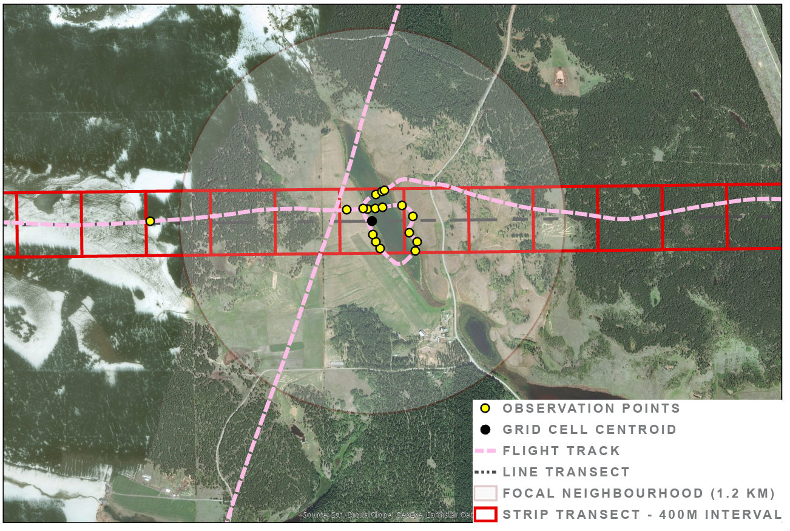
Survey Design Schema – Observation Data
Notes:
This is a schematic representation of the survey design with observation data from 2017. Bird observations are in yellow, and the dotted pink line is the tracklog. The red squares represent the boundaries of the strip transect split into 400m intervals. The black dot in the middle is the centroid of a grid cell to which the point counts were aggregated, and the pale circular buffer is representative of the focal neighbourhood used to generalize the environmental predictors to capture landscape level effects.

Slide 10

Model Selection – Random Forest
Predictive accuracy
Intuitive, Flexible
R ‘party’ package (cforest)
Variable Importance
“unbiased” but processor-intensive
Vankar Jaganath CC
Notes:
For the capstone project I focused on a Random forest model – briefly, it’s a machine learning method that takes a random subset of your data, splits it along a decision tree into finer and finer branches with each split on a node based on a variable selected from within a random subset of candidates so that the variance between the branches is maximized. And this is repeated over and over again to create an ensemble or a forest of trees from which the final model that best explains the data is selected.
I went with this approach not just because all the cool kids are doing it but for its predictive power and accuracy which is well established. It’s also intuitive—a decision tree is like an identification key, and flexible – it can handle categorical and continuous data and isn’t dependent upon any particular distribution. My frequency counts aggregated to that 400m grid cell followed a zero-inflated, negative binomial distribution – which is typical of ecological count data but did limit regression-based approaches. And due to random variable selection and bagging (or bootstrapped aggregation) it doesn’t overfit the model.
There are a number of packages and programs out there but I went with the R party package and specifically, the cforest function. It’s open-source and “unbiased” does not favour continuous data or categorical data with many classifications unlike Brieman’s proprietary Salter Systems software. But of course there’s a trade-off and it’s very processor-intensive.
When I first started out, armed with naïve enthusiasm, I threw everything that I had at it—all of my data. I clicked ‘enter’ and waited excitedly for the results. But my wait lasted for hours which turned into days and into a week and a week and half without any results before I finally escaped the grip of the sunken cost fallacy and killed it. There was definitely a lot more data processing and work I did to narrow the variable selection that involved addressing correlations and multicollinearity, eliminating near-zero variance candidates, identifying imbalanced classes, creating indices to get around collinearity…and so on.

Slide 11



Tools and Technologies
Data Exploration & Visualization
ArcGIS – Spatial Statistics
Data Wrangling and Processing
R/Rstudio (‘caret’, ‘tidyverse’)
Python
Documentation and Collaboration
Jupyter Notebook
Notes:
Before I share the results I would like to quickly highlight tools and technologies I used and found useful. For data exploration and visualization, I use ArcGIS Desktop daily and am familiar with the interface but Pro was new to me and I took advantage of the newer Forest-based Classification and Regression tool –from which I do have some comparative outputs. I also explored Hot Spot, Exploratory Regression, and Ordinary Least Squares these were all useful for playing with the data at different scales.
For data wrangling and processing, I used Python and R extensively. ArcGIS is great for what it is – a full-featured platform with all the bells and whistles, but when it came to manipulating these large datasets the GUI interface was super clunky and glitchy. I prefer a light-weight modular scripting approach.
In R, I belatedly discovered the ‘caret’ package which is designed specifically for data science, has functions for each step of the modeling process from data prep to model evaluation– if I’d known of it earlier it would have saved me from spending as much time as I did on Stackoverflow.
I love Python and the Script Toolbox was a great container for repeated tasks. I like to automate wherever possible – not to imply that I’m lazy but if I can make my computer work on my behalf, I’m all over it.
Jupyter notebook was super useful for sharing and documenting code snippets and workflows. The interactive Jupyter notebook is a web-based application that allows you to combine text, equations, images, and live code all in one. If there’s time at the end I can share this live link with you to a copy I have on Github.

Slide 12
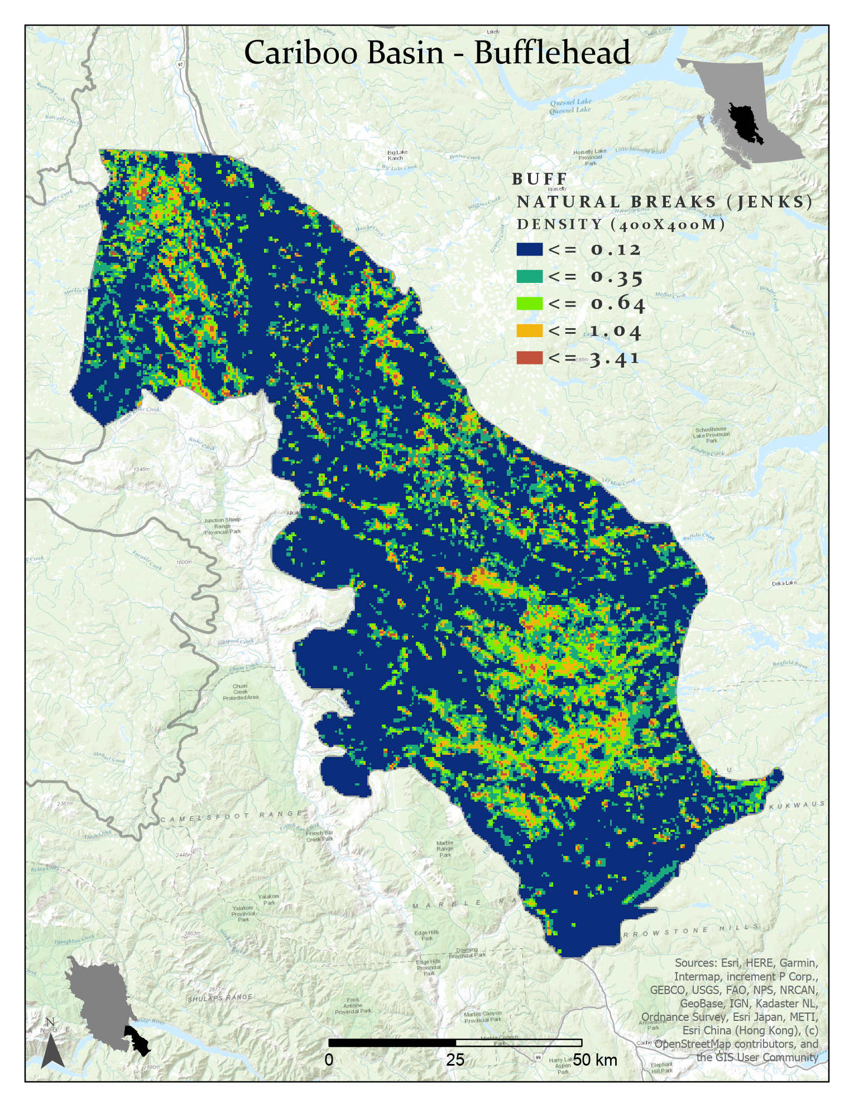
Species Distribution Model Results - Example
Bufflehead - Variable Importance
Variable | Rank
Shoreline (<10 ha) | 1
Streams (≤3 order) | 2
Lakes < 1 ha | 3
Shoreline (>10 ha) | 4
Lakes 3-5 ha | 5
 | RMSE | Rsquared | MAE
Bufflehead | 1.006 | 0.233 | 0.327
Notes:
This is a peek at the results. I created models for the top 10 most common species as well as five groups based on life history traits. This is a map for Bufflehead in the Cariboo Basin ecosection with low to high densities mapped from blue to red. And the results of the top 5 variable importance measures confirm Stuart Pimm’s keen observation that “Ducks like water”.
The rsquared for this particular model was 0.23 which was about the average performance of the models I generated and for an ecological study isn’t bad.
So next steps, first I need to write this all up and graduate (fingers crossed) but I will soon be working with colleagues to fine-tune the model parameters with improved data inputs Hopefully, I’ve made this look easy, it’s actually been a very challenging project. But I now have the reward in sight and that will be to see the models operationalized and sitting in a newly expanded conservation toolkit.
Thank you very much.

Slide 13
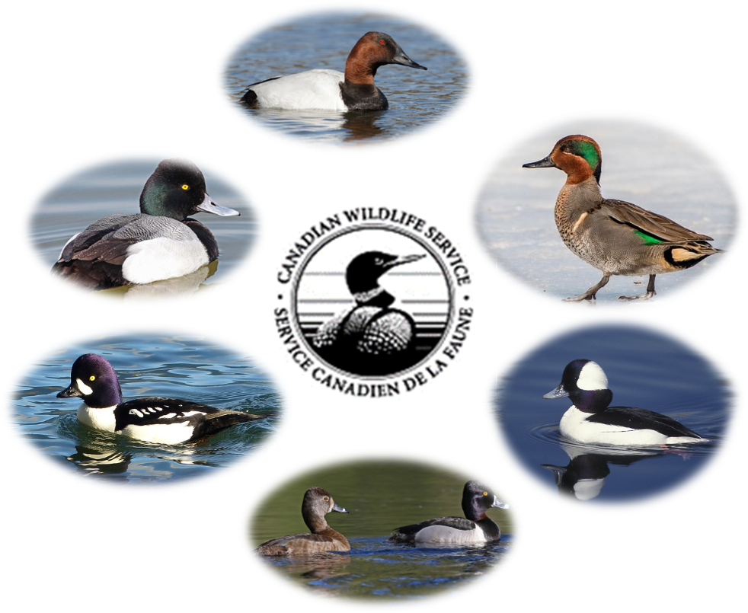
Images – Cornell, Macaulay Library

Slide 14
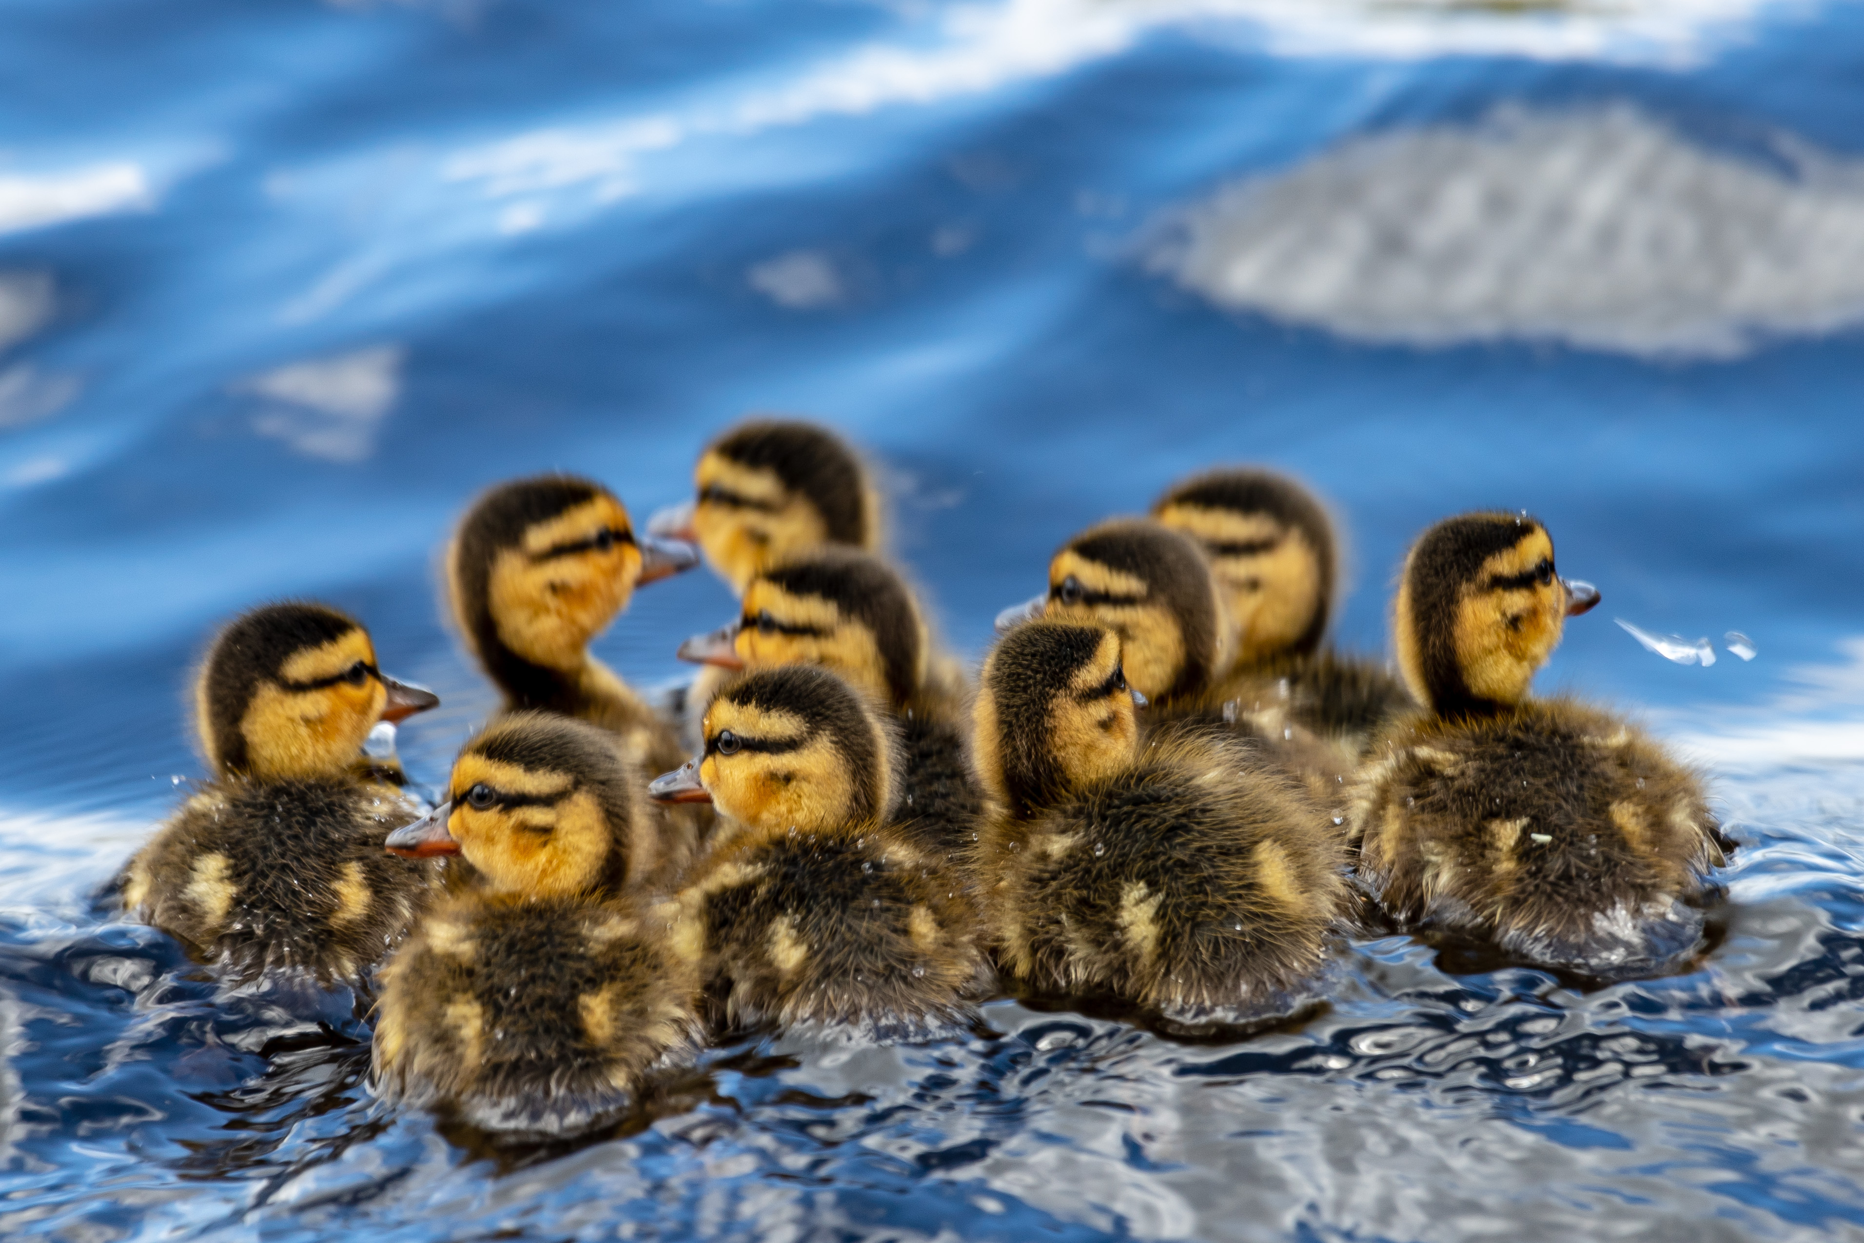
Model Interpretation
J.Avery
“The single story creates stereotypes, and the problem with stereotypes is not that they are untrue, but that they are incomplete. They make one story become the only story.”
- Chimamanda Ngozi Adichie
Notes:
Share only if you’ve rushed through the presentation and have time.
This study was undertaken to assist the CWS, governmental and other partners to recognize the utility of SDMs to assess our efforts and provide guidance in support of place-based decision-making and science-based conservation action. The existing BC Breeding Waterfowl Surveys dataset was leveraged to predict distributions to un-sampled areas through the full extent of BC’s central interior. It is hoped this example will stimulate investment in model development and the creation of value-added data products with the following caveat in mind:
“The single story creates stereotypes, and the problem with stereotypes is not that they are untrue,
but that they are incomplete. They make one story become the only story“ (Adichie 2009).
With the quote above, the Nigerian author Chimamanda Ngozi Adichie was referring to the flawed conclusions that limited perspectives such as stereotypes facilitate—that any single observation or narrative however true is not fully representative. Similarly, a species distribution model is a single story: a simplified human construct of a complex phenomenon shared to reveal processes and patterns through a single lens.
Models, like stories, must be developed and communicated in meaningful ways to be useful. Future studies are encouraged to validate and build upon these results by exploring and employing best available methods and data. Encouraging technological developments include alternative community-based population models that take into account species interactions (Guisan, Wilfried, and Zimmermann, 2017) and the development of remote sensing techniques and data to delineate wetlands by season and type (Gabrielsen, Murphy, and Evans 2016; Halabisky et al. 2018; Mahdavi et al. 2018). Models are useful only when they help bring together expert opinion, ecological principles and systematic monitoring and research in a comprehensive framework that leads to conservation action (Sinclair et al, 2010).
These models tell just a single story, but it is a story worth telling in support of waterfowl conservation in British Columbia.

